Slide 1
Final Presentation
Randy & Dylan

Slide 2
Content Page
Recap
Phases of Design Thinking
Timeline
Prototype
Blocking of seats
Issuing tickets
Area of Improvement/Reflection
Demo
Question and Answers

Slide 3
Project Background
To propose a solution to automate ushering process for mega event conducted in NYP (e.g graduation). The solution aims to reduce the printing of paper tickets and improve work productivity by automating the planning process. We are also planning to cater to alumni events too. We applied design thinking phases for this project to aid us.Additionally, the platform will be responsive.

Slide 4
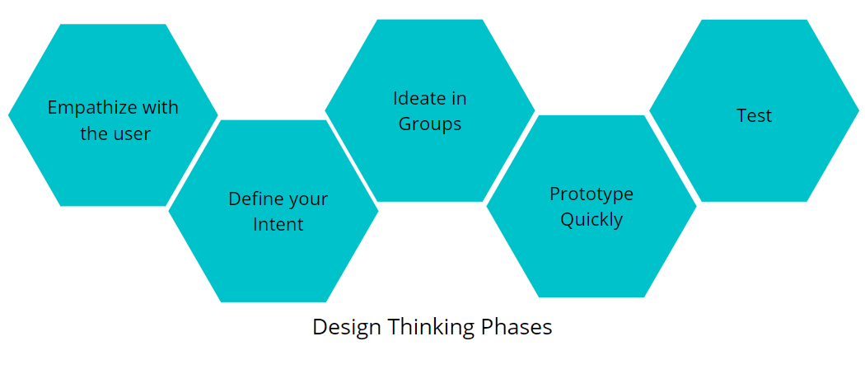
Design Thinking Phases

Slide 5
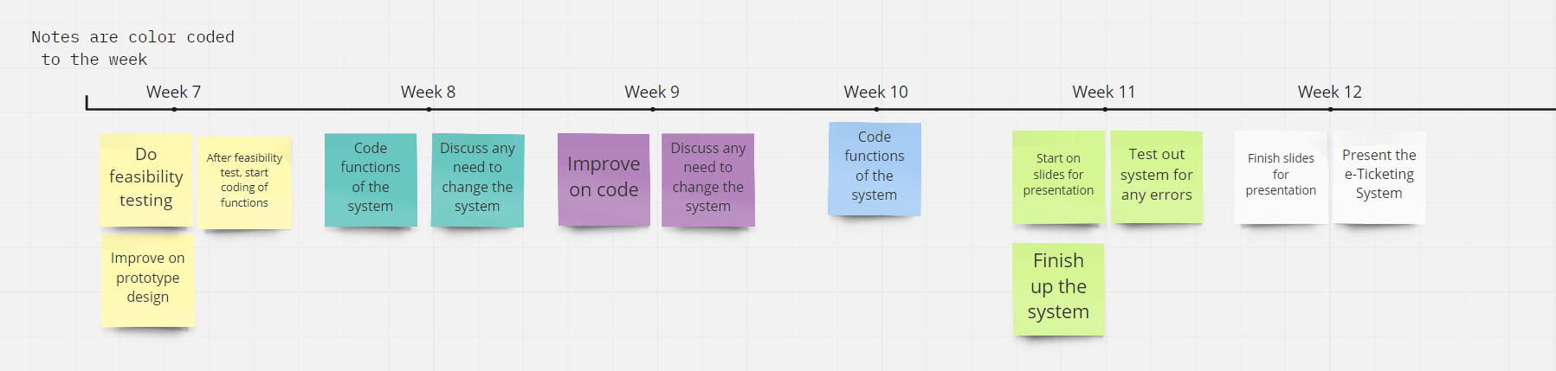
Timeline (Week 7 to Week 12)

Slide 6
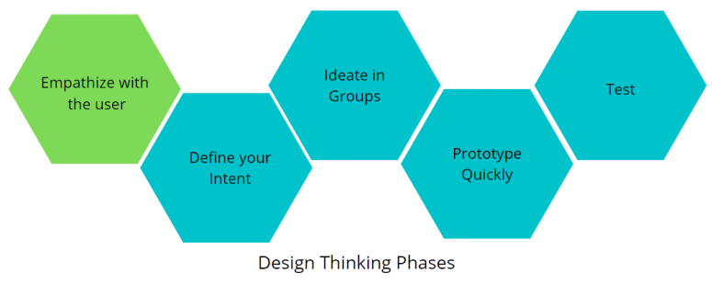
Phase 1: Empathize with the users
- 50 ideas
- Selection Matrix
- Proposed Solution
- Empathy Map
- Journey Map
- Mind Map
- Problem Statement
- How Might We
- Interview

Slide 7
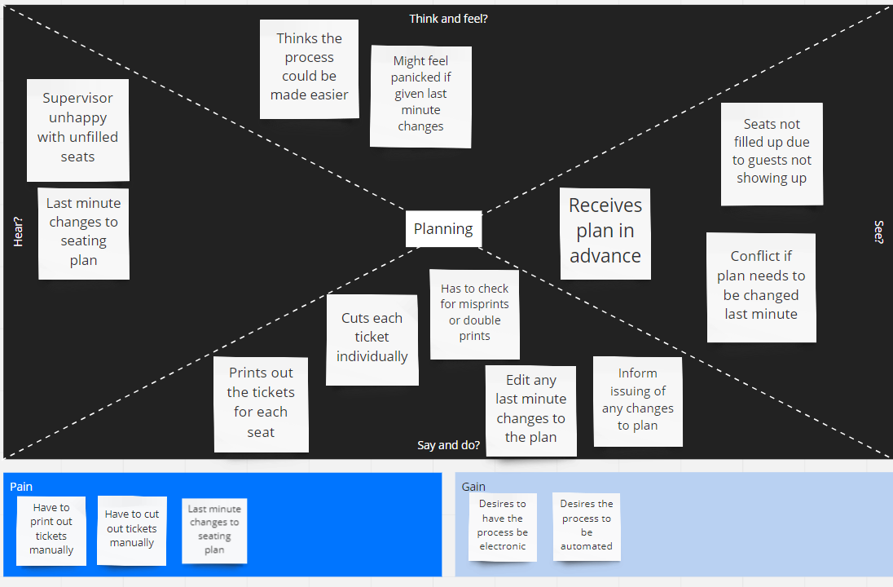
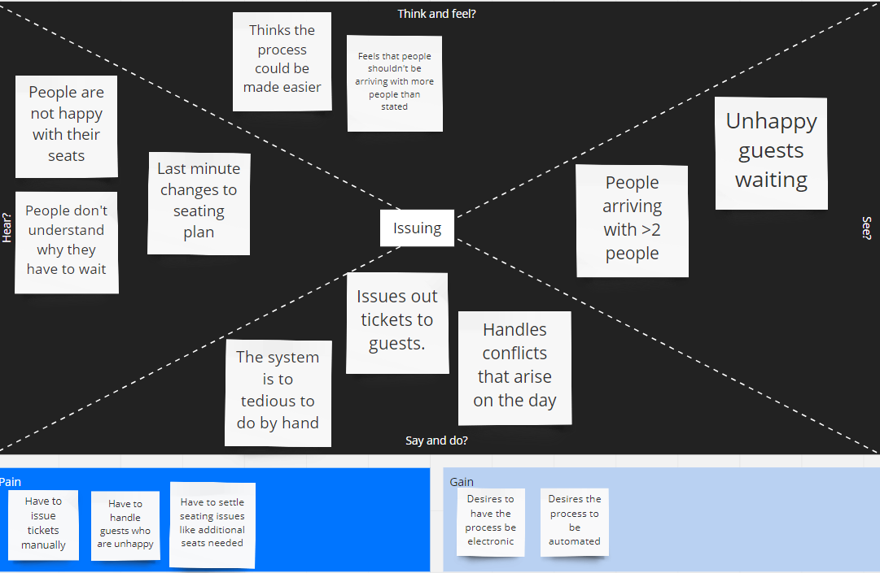
Empathy Map
Left is Planner, Right is issuer

Slide 8
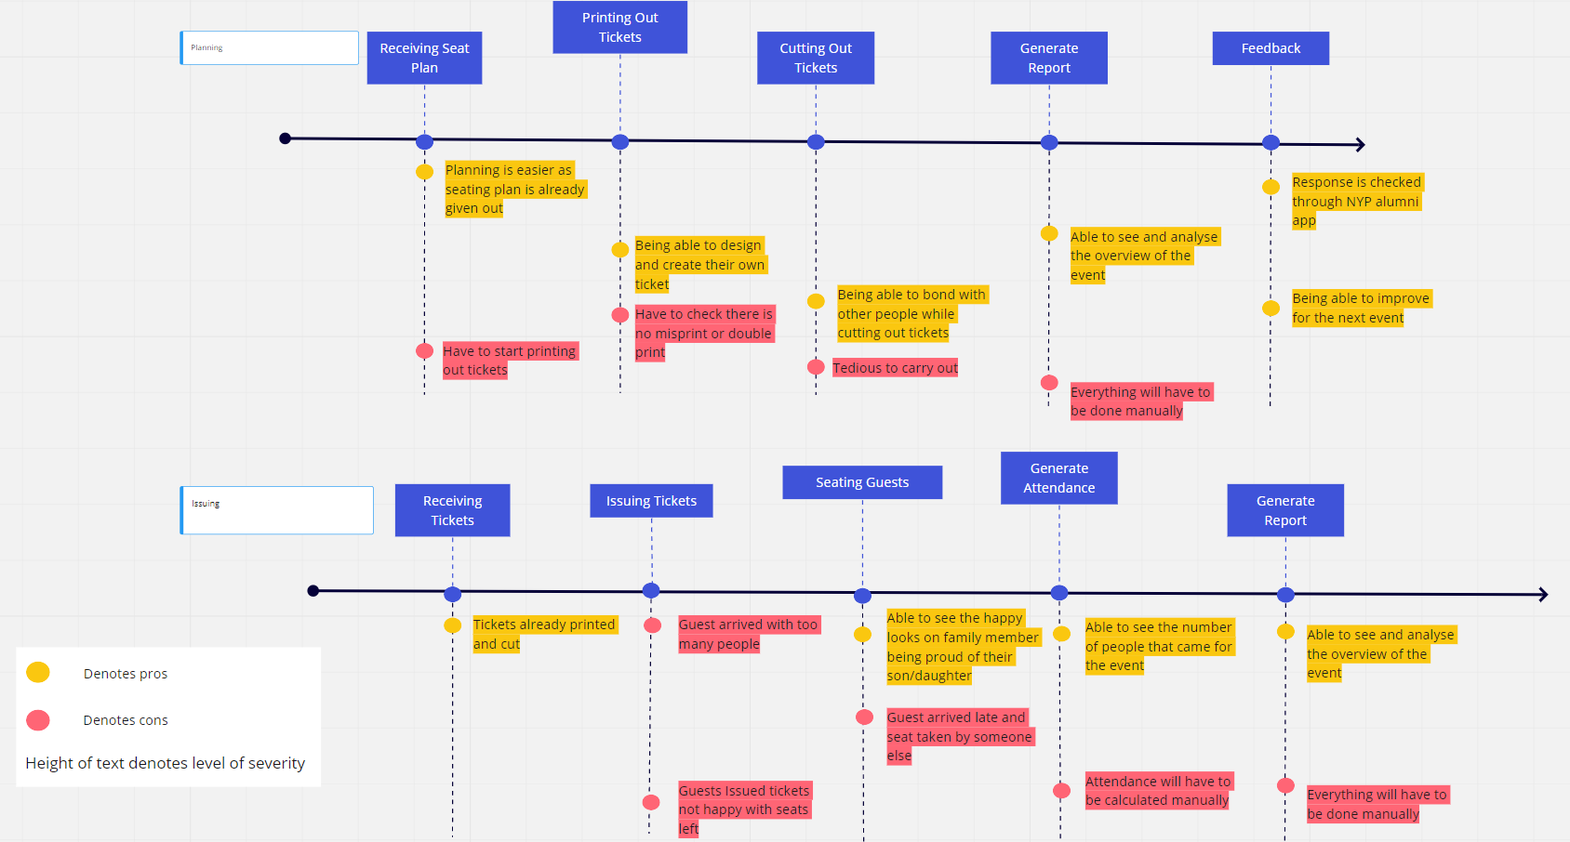
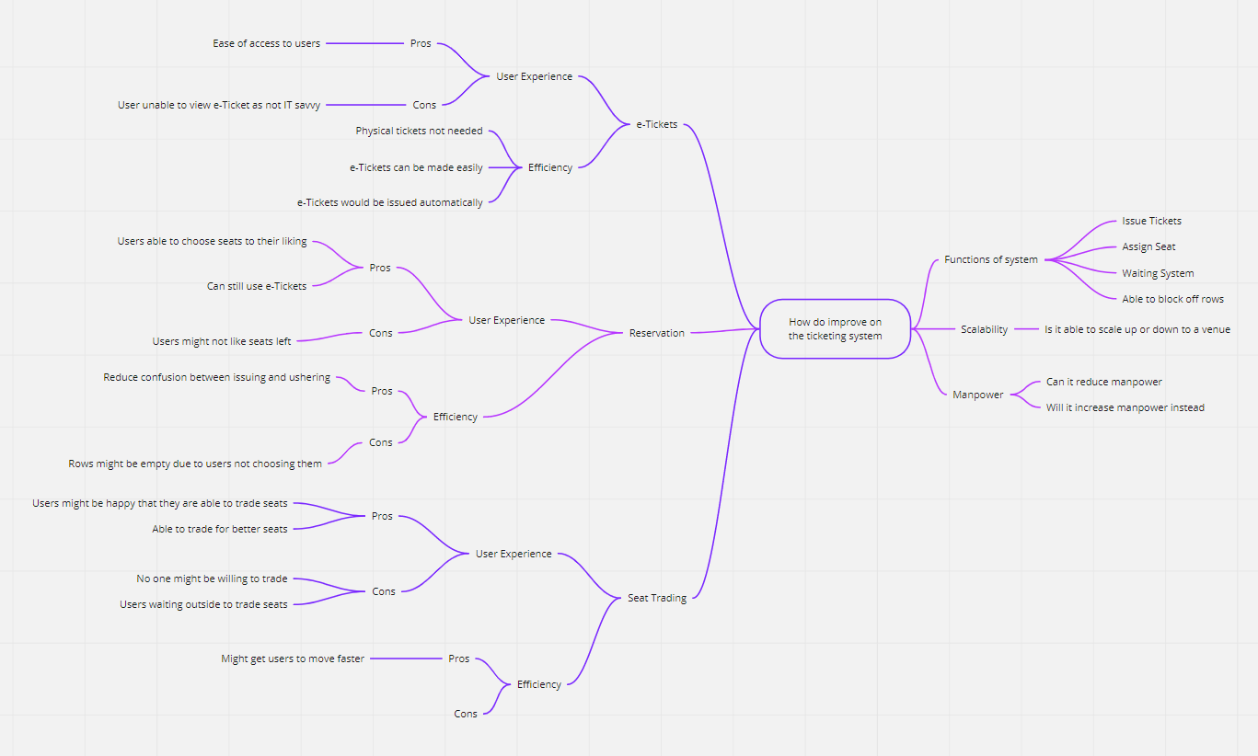
Journey Map & Mind Map

Slide 9
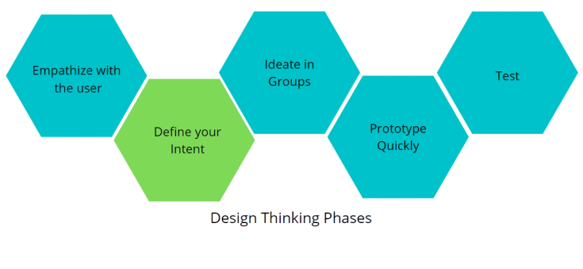
Phase 2: Define your intent
- 50 ideas
- Selection Matrix
- Proposed Solution
- Empathy Map
- Journey Map
- Mind Map
- Problem Statement
- How Might We
- Interview

Slide 10
Problem Statement
The problem with the current method of how things works are that huge amount of manpower are used to plan these events. Printing and checking of tickets are tedious and requires huge amount of time do them. Attendance taking and other reports are also done manually. It is tedious and sometimes there will be error too. Since we are not only dedicating this platform to only 1 venue. We have to make it dynamic so that it will be responsive to other types of venues too. Conflicts are definitely bound to happen but the most common conflict would be guest bringing more that stated guest on the day itself.

Slide 11
How Might We (Planner)
How Might We (Guest)
How Might We (Ushering & Ticket Issuer)
How might we help planners ease the usage of manpower?
How might we make planning smoother for planners?
How might we make the platform easy to use by all ages?
How might we make guest understand about seat reservation?
How might we make guest with extra guests be happy with compromises?
How might we make guest experience good and smooth?
How might we guest understand their seating arrangement?
How might we reduce guest conflict between guest and usher?
How might we make the process less tedious and messy?
How might we reduce the use of paper to save the environment?
How might we satisfy all type of guest?
How might we help out the ushers and ticket issuers?

Slide 12
Interviews
Ms Kareen Koh (Planner)
JunJie & Sherwinn (Event Supervisor and Ticketing)
Ms Loh Moi Yong (Planner)

Slide 13
Ms Kareen Koh
In-charge of handling movie nights and entrepreneurship talk/networking talk
Entrepreneurship/Networking talk
No seating arrangement, first come first serve
Movie Nights
Start from middle to back seats, filling up on the middle 6-8 seats, proceeding to the back row till all the middle seats are filled.
Work on the seats left and right from the middle
Alumni are involved as well for ushering and giving out tickets
Does not have any limitation/difficulties so far (have not encountered any)
Movie Theatre does include handicap seats
Does have conflicts
Customers not happy with their seats
Late customer found other people seating in their seats

Slide 14
JunJie
Sherwinn
In-charge of attendance, ushering, supervising and handling conflicts
Common conflict
Max is only 2 people where a lot of group came in more than 2
In-charge of issuing tickets
Process
Signup through link
Scanning QR Code on phone
Issuing tickets manually
What he does not like
Ticket are not automatic, resulting in lots of manpower used and messy
Conflicts
Most common conflicts would be people not liking their seats as they are first come first serve
What they would like to have in the app
Waiting list for extra people

Slide 15
Ms Loh Moi Yong
In-charge of color-coding, planning seats and printing out tickets
Preparation are done months beforehand
Her difficulty would be having to cut out the tickets

Slide 16
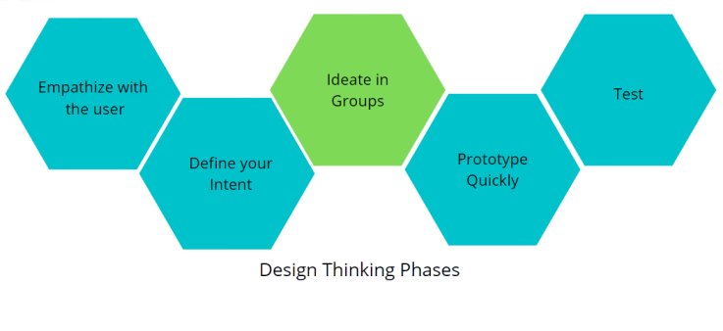
Phase 3: Ideate in Groups
- 50 ideas
- Selection Matrix
- Proposed Solution
- Empathy Map
- Journey Map
- Mind Map
- Problem Statement
- How Might We
- Interview

Slide 17
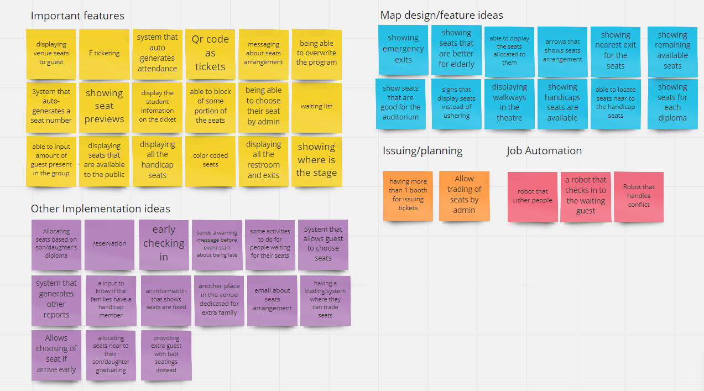
50 Ideas

Slide 18
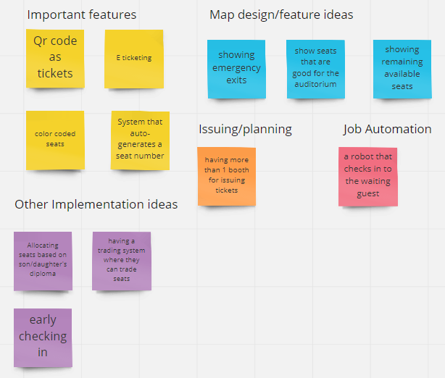
50 Ideas

Slide 19
Selection Matrix
Idea selected (Score) | Desirability | Feasibility | Viability | Novelty
e-Ticketing (10) | 3 | 3 | 3 | 1
Waiting List(7) | 2 | 2 | 2 | 1
Generating Reports(9) | 3 | 3 | 2 | 1

Slide 20
Proposed Solution
Our proposed solution would be an e-Ticketing system that would issue users tickets based on the availability of seats. It should also be easy to use and navigate for all ages.

Slide 21
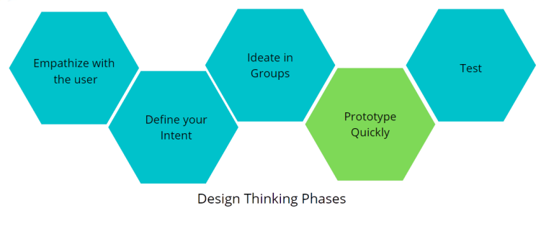
Phase 4: Prototype Quickly
- 50 ideas
- Selection Matrix
- Proposed Solution
- Empathy Map
- Journey Map
- Mind Map
- Problem Statement
- How Might We
- Interview
Notes:
Mention it is not finalised yet and it is still drafting

Slide 22
Function List
Planner
Able to pick venue
Able to block off certain rows and reserve seats
Able to key in date and time for the event
Save/Edit/Cancel Button
Issuing Tickets/Usher
Auto generate seats
Send message about seating arrangement for reference for usher (e-Ticketing)

Slide 23
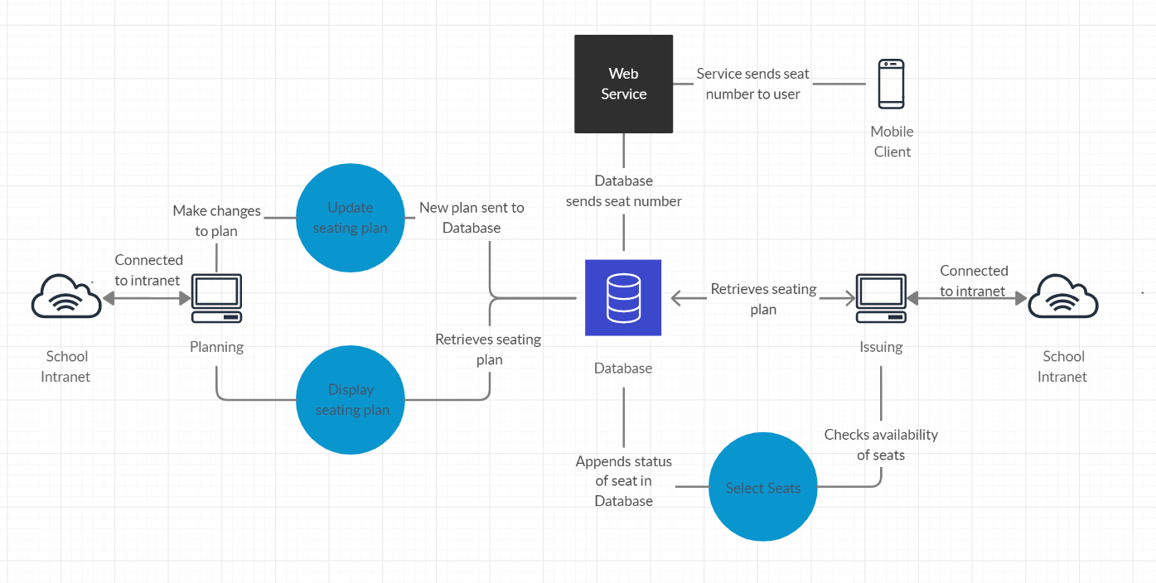
System Diagram

Slide 24
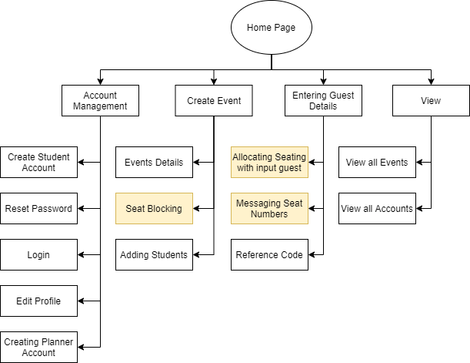
Site Map

Slide 25
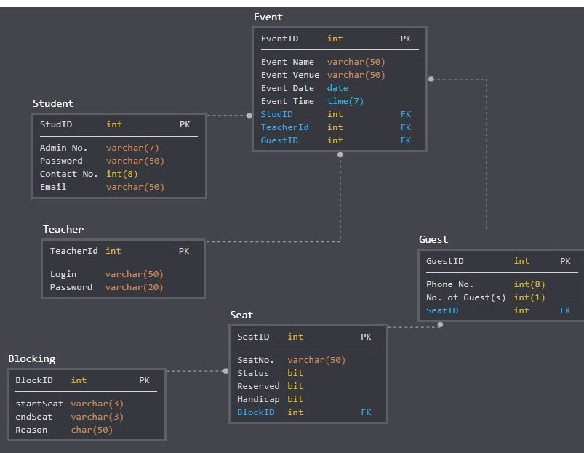
Database Design

Slide 26
Phase 4: Prototype (Student Side)
- 50 ideas
- Selection Matrix
- Proposed Solution
- Empathy Map
- Journey Map
- Mind Map
- Problem Statement
- How Might We
- Interview
Notes:
Mention it is not finalised yet and it is still drafting

Slide 27
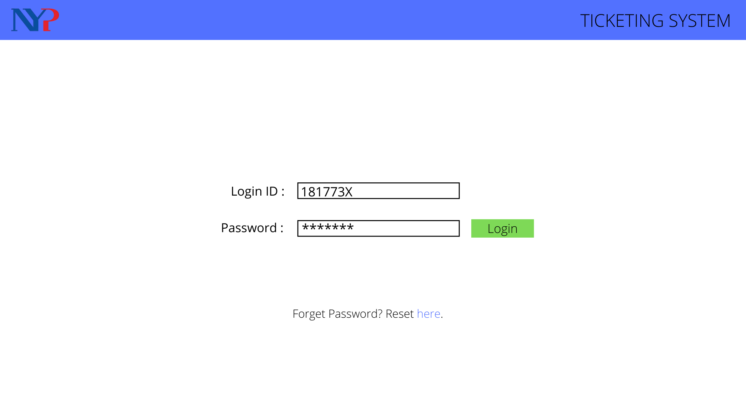
Login Page

Slide 28
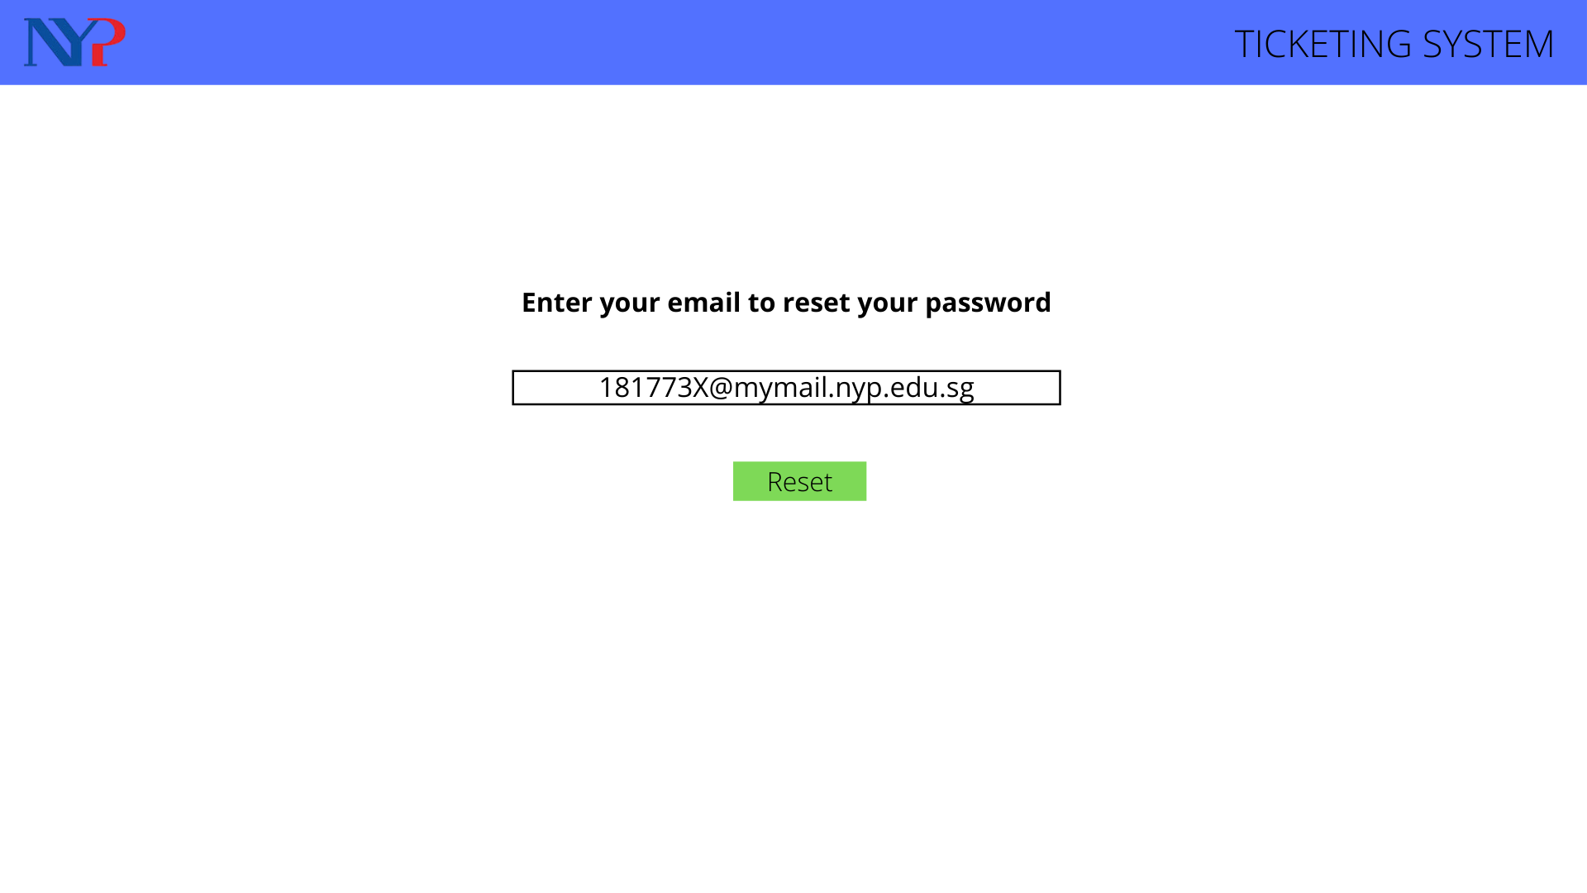
Resetting Password

Slide 29
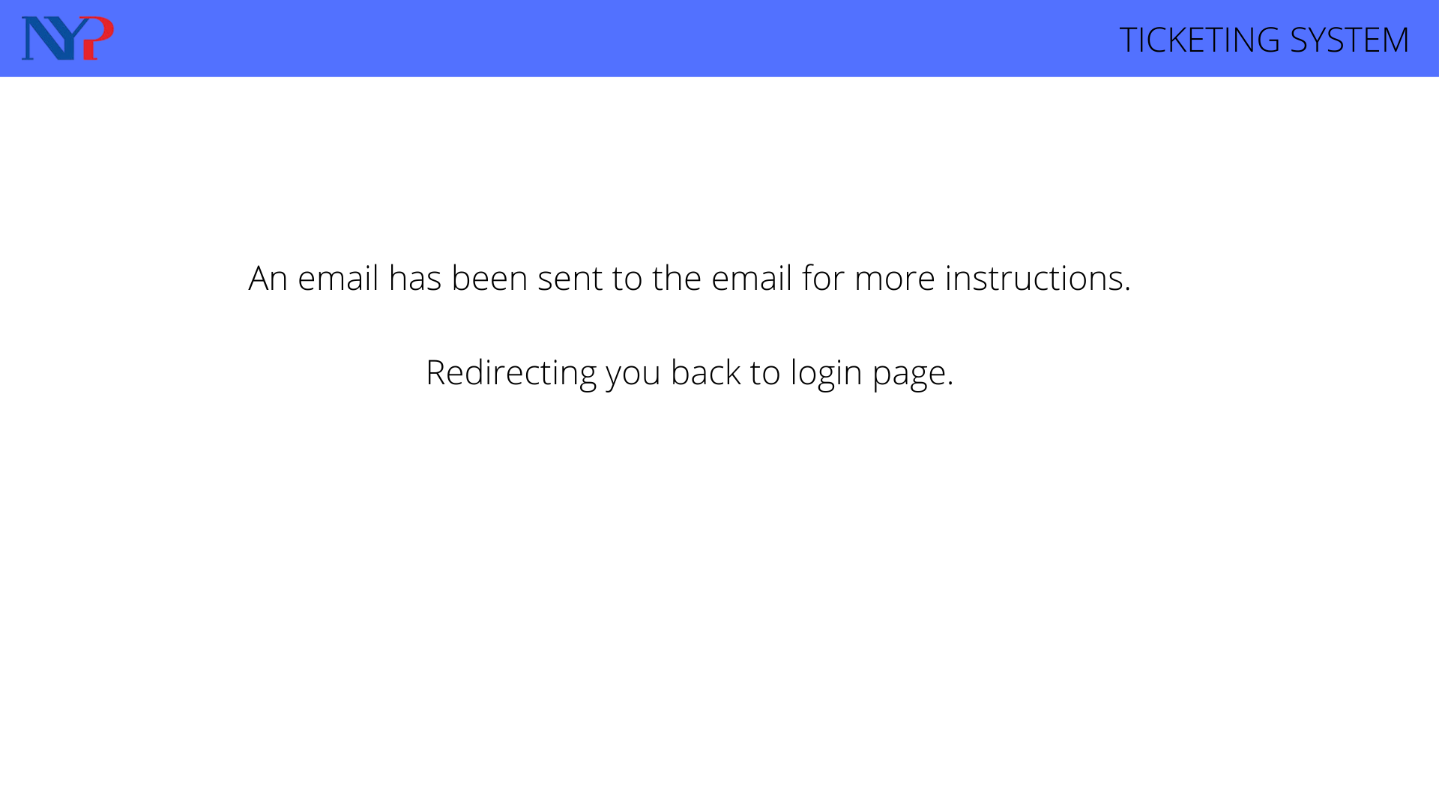
Confirmation

Slide 30
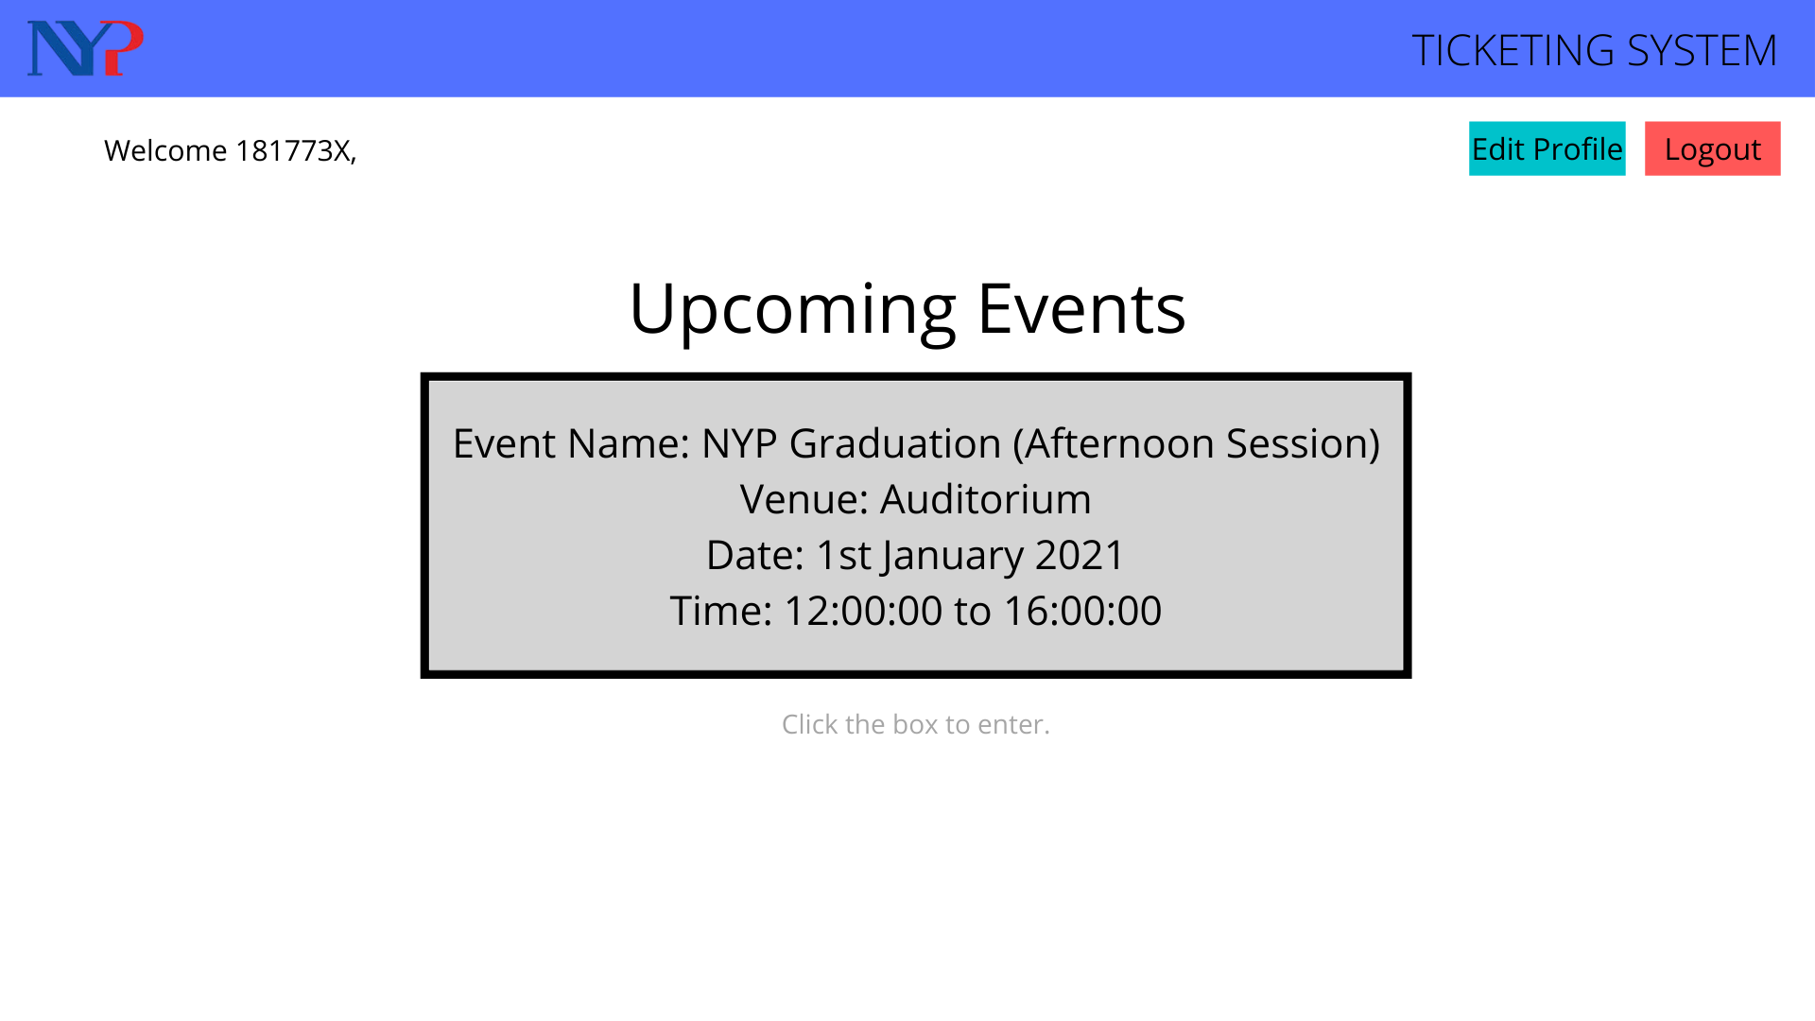
Dashboard

Slide 31
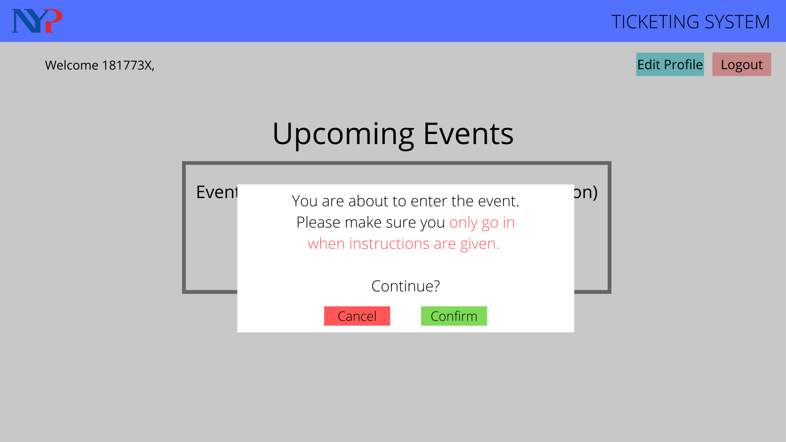
Confirmation Page

Slide 32
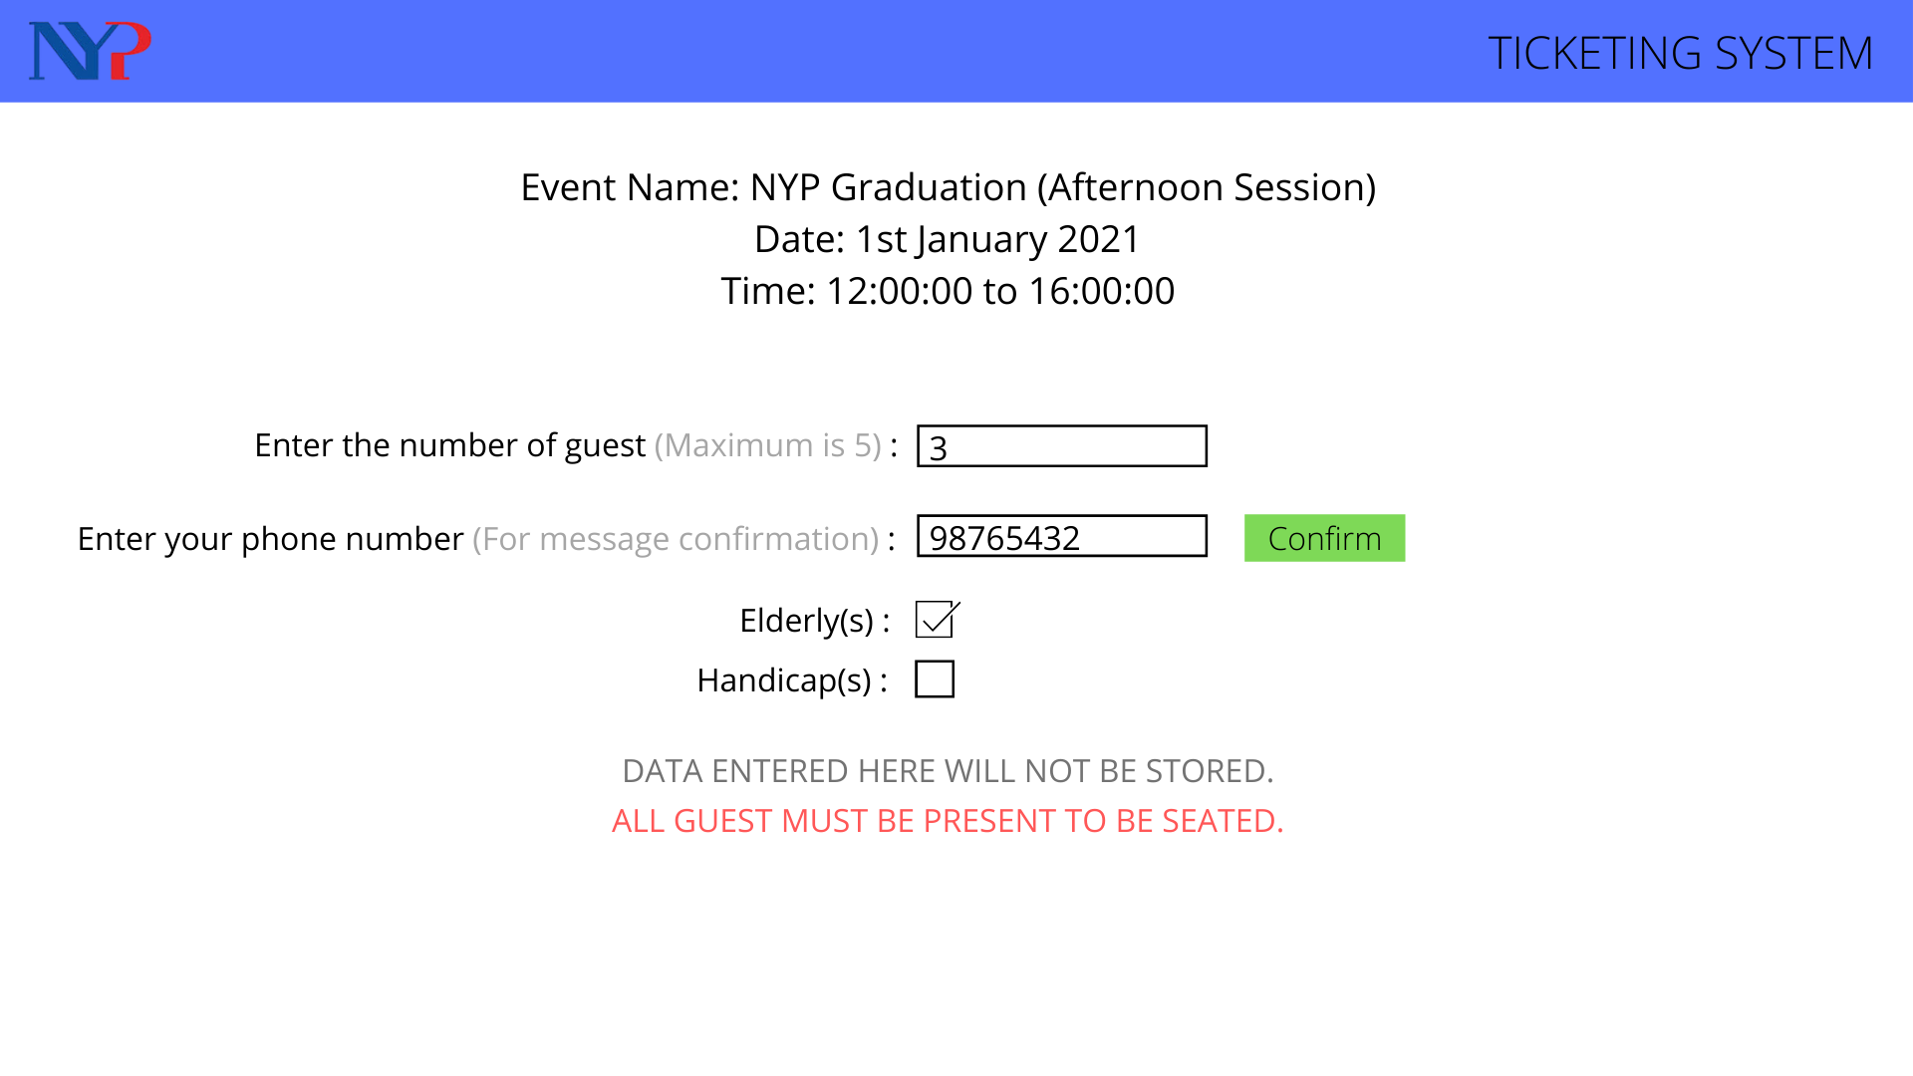
Event Page (Ticker Issuer)

Slide 33
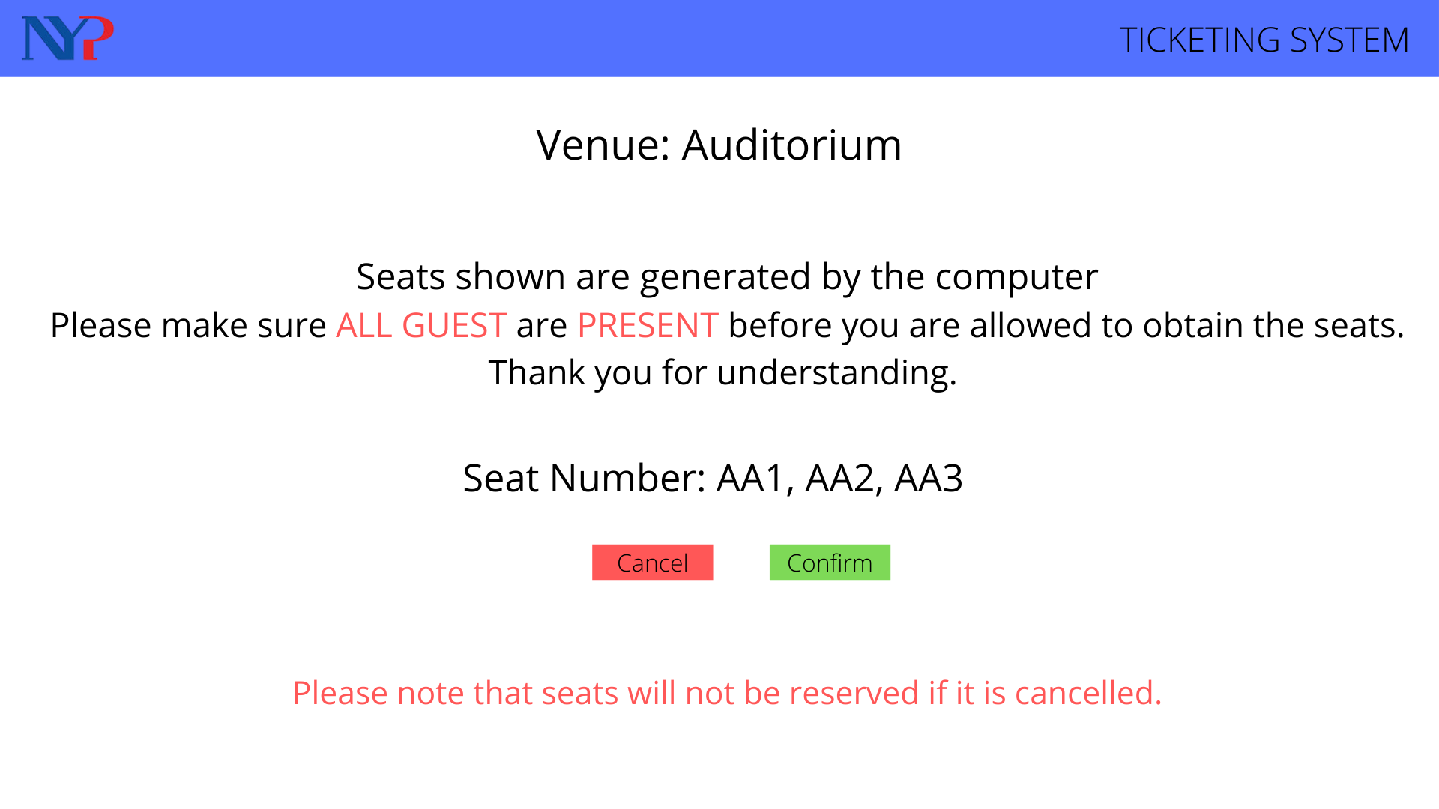
Warning Page (Ticker Issuer)

Slide 34
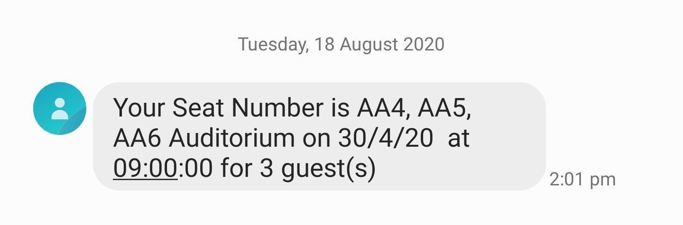
SMS Output (Ticker Issuer)

Slide 35
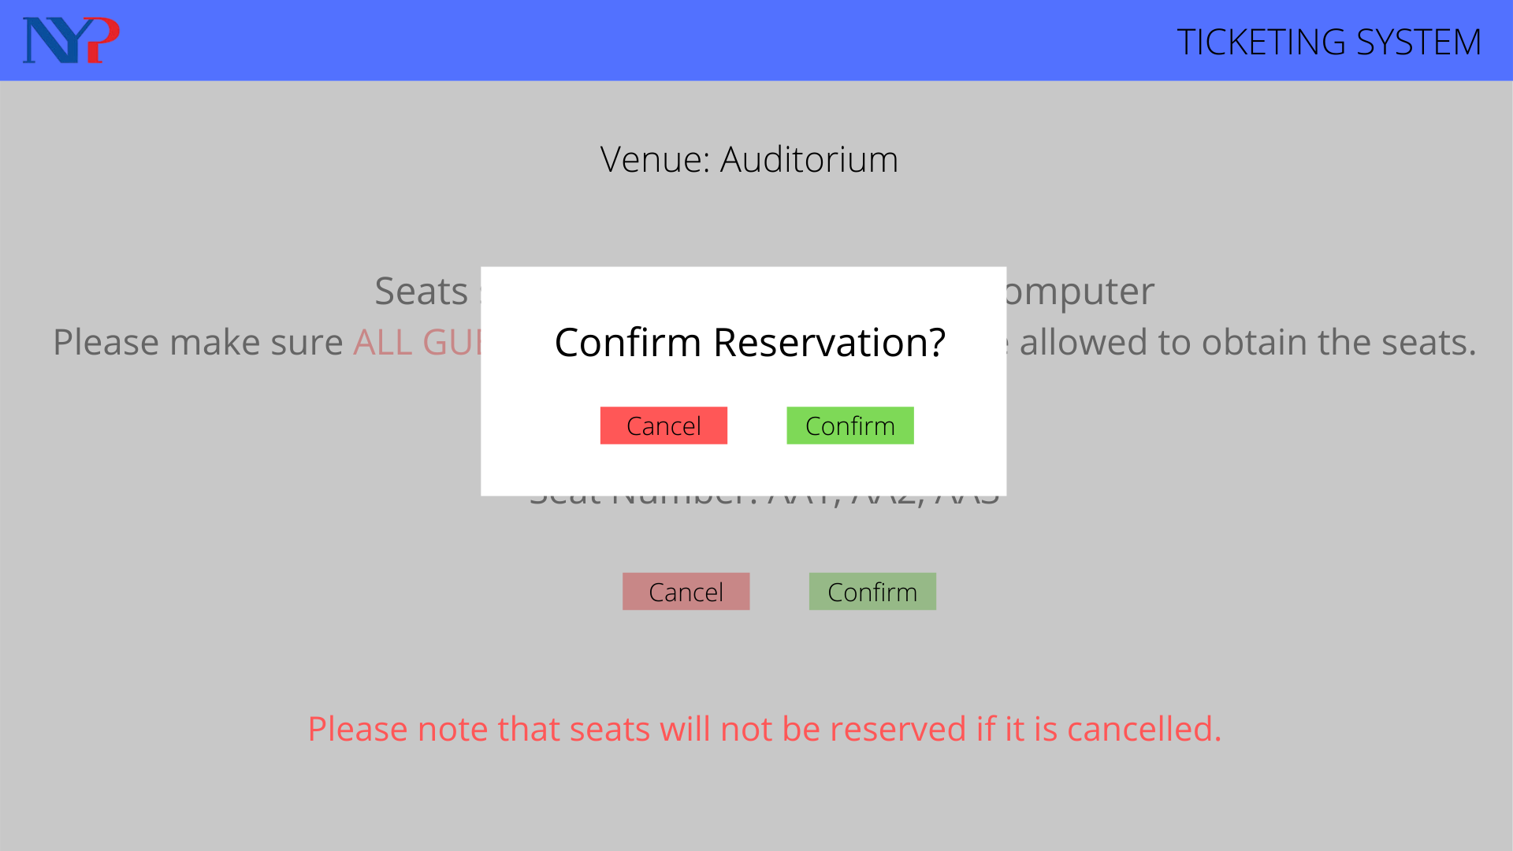
Confirmation Page

Slide 36
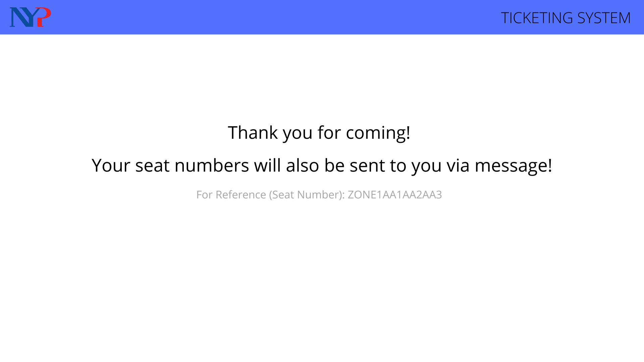
Completion Page

Slide 37
In a event of cancellation

Slide 38
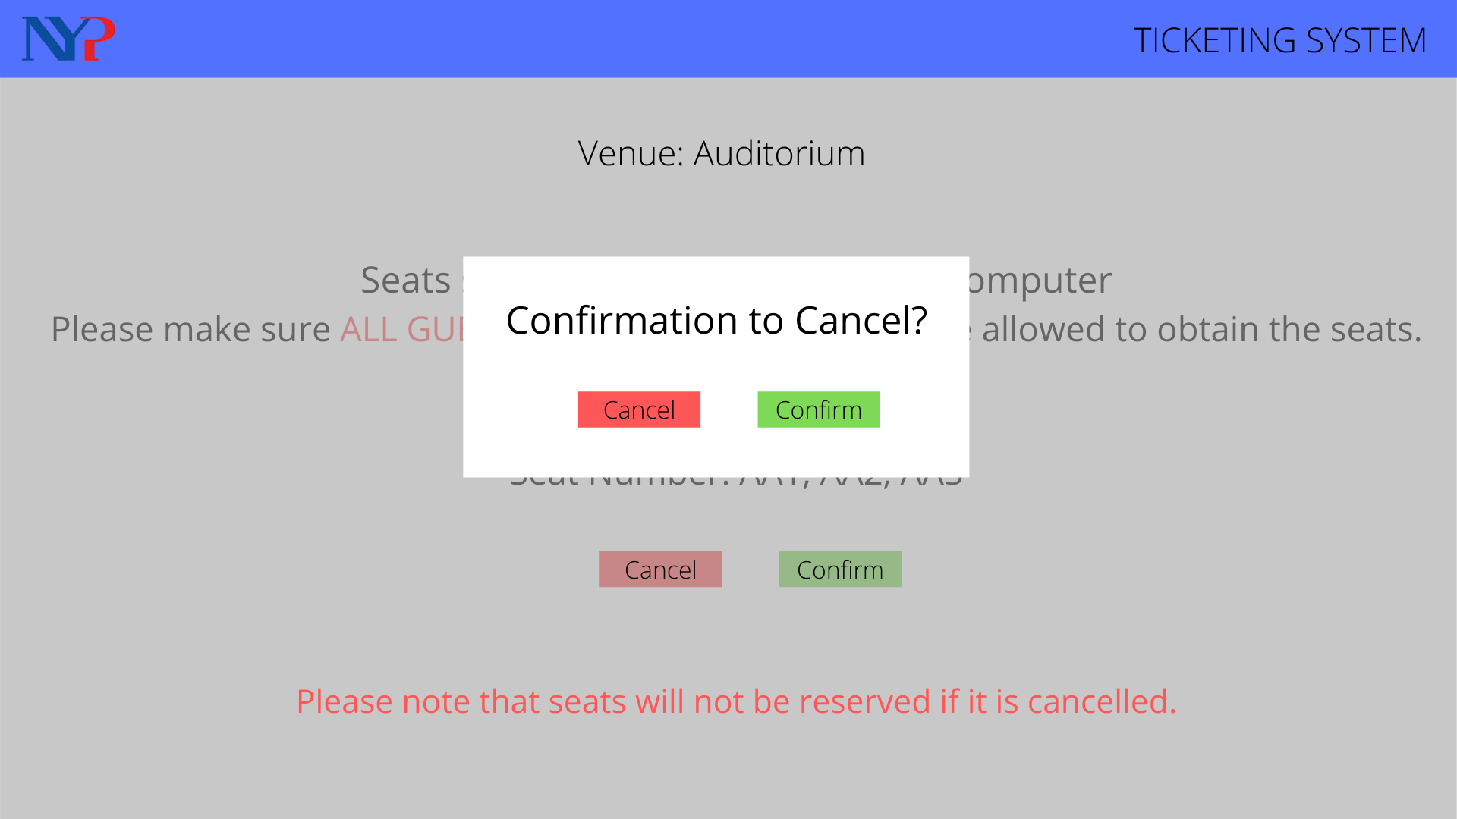
Cancellation Page

Slide 39
Event Page

Slide 40
Phase 4: Prototype (Planner Side)
- 50 ideas
- Selection Matrix
- Proposed Solution
- Empathy Map
- Journey Map
- Mind Map
- Problem Statement
- How Might We
- Interview

Slide 41
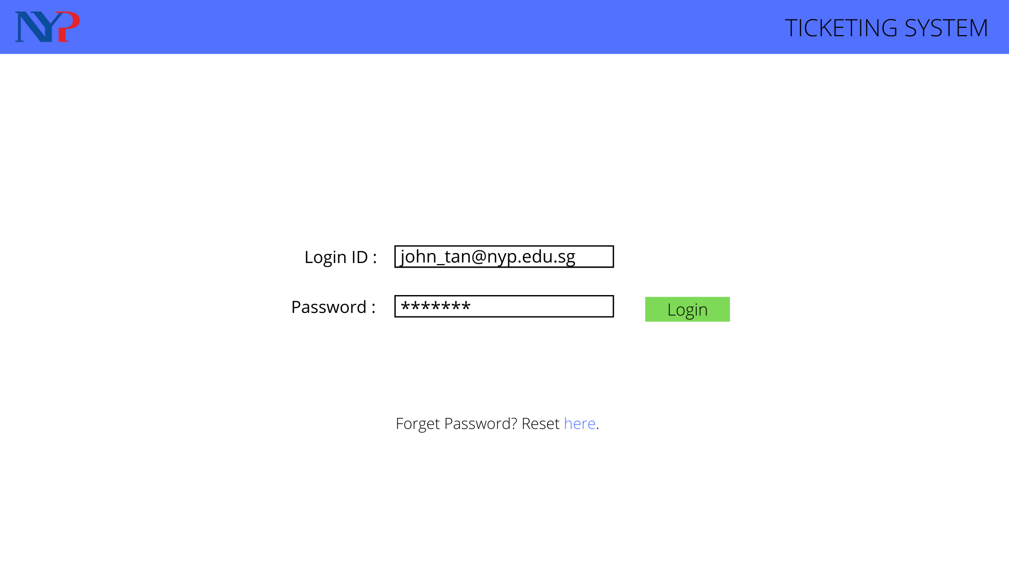
Login Page

Slide 42
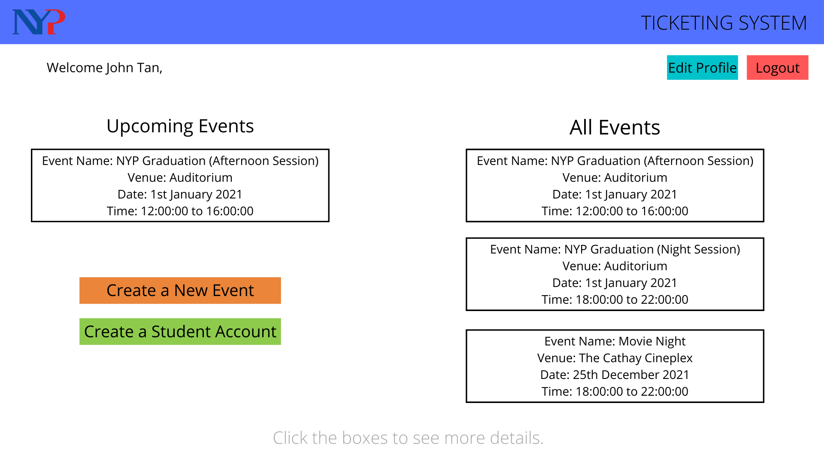
Dashboard

Slide 43
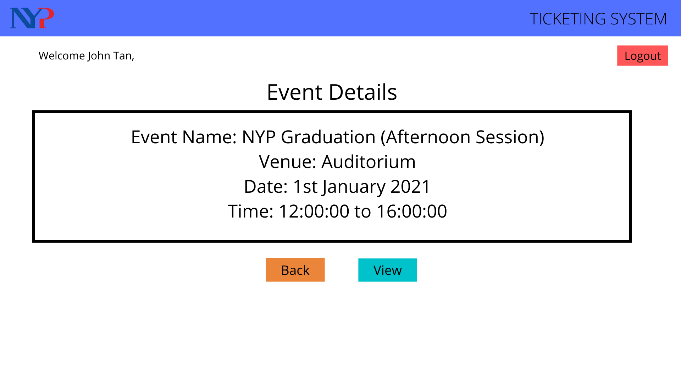
Minimum Event Details

Slide 44
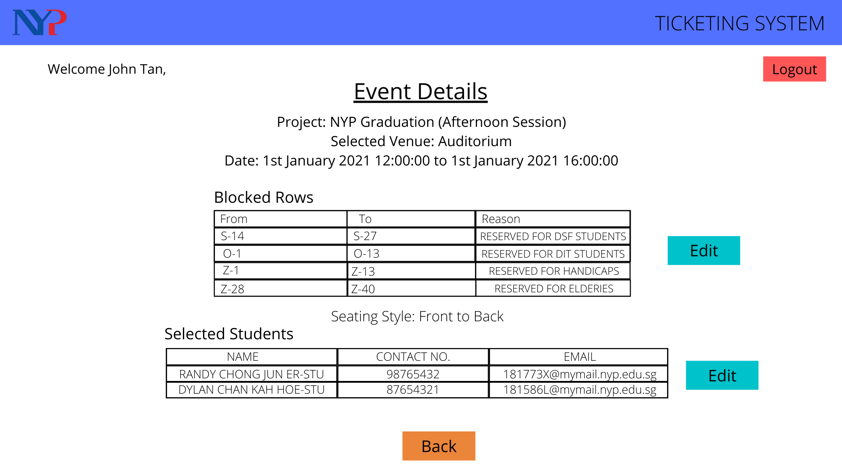
Full Event Details

Slide 45
Creating New Event

Slide 46
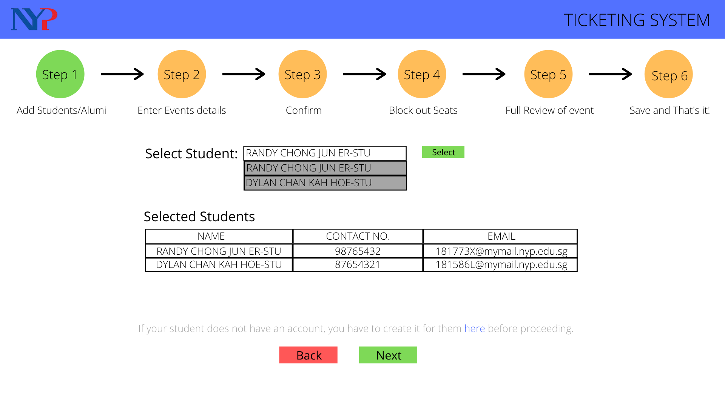
Adding Students

Slide 47
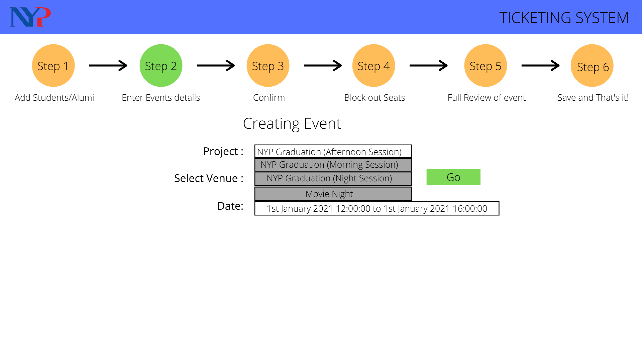
Selecting Event Venue and Name

Slide 48
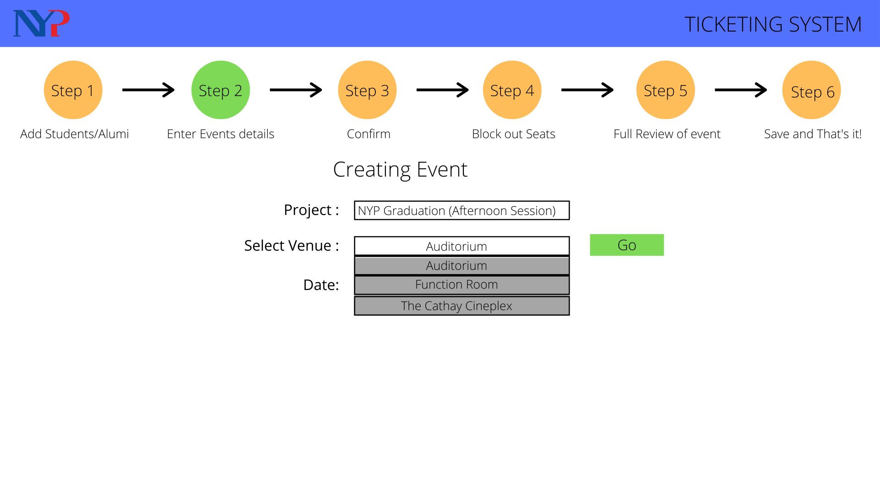
Dropdown List

Slide 49
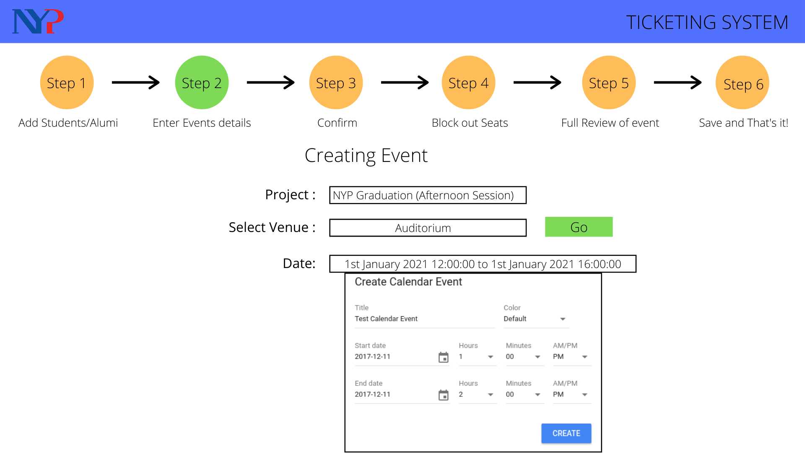
DateTime

Slide 50
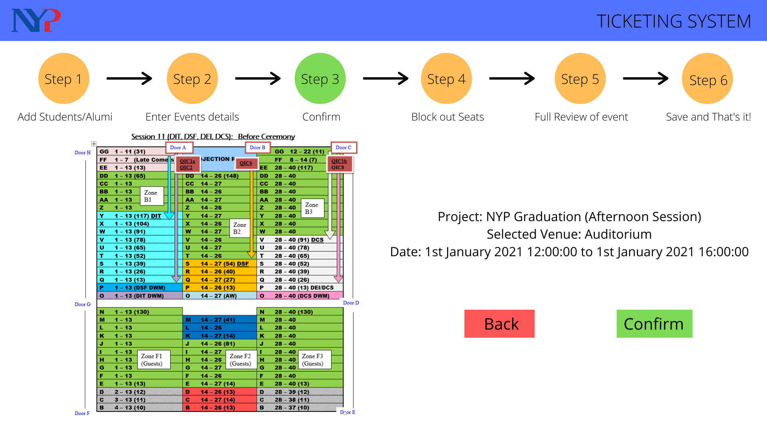
Event Confirmation

Slide 51
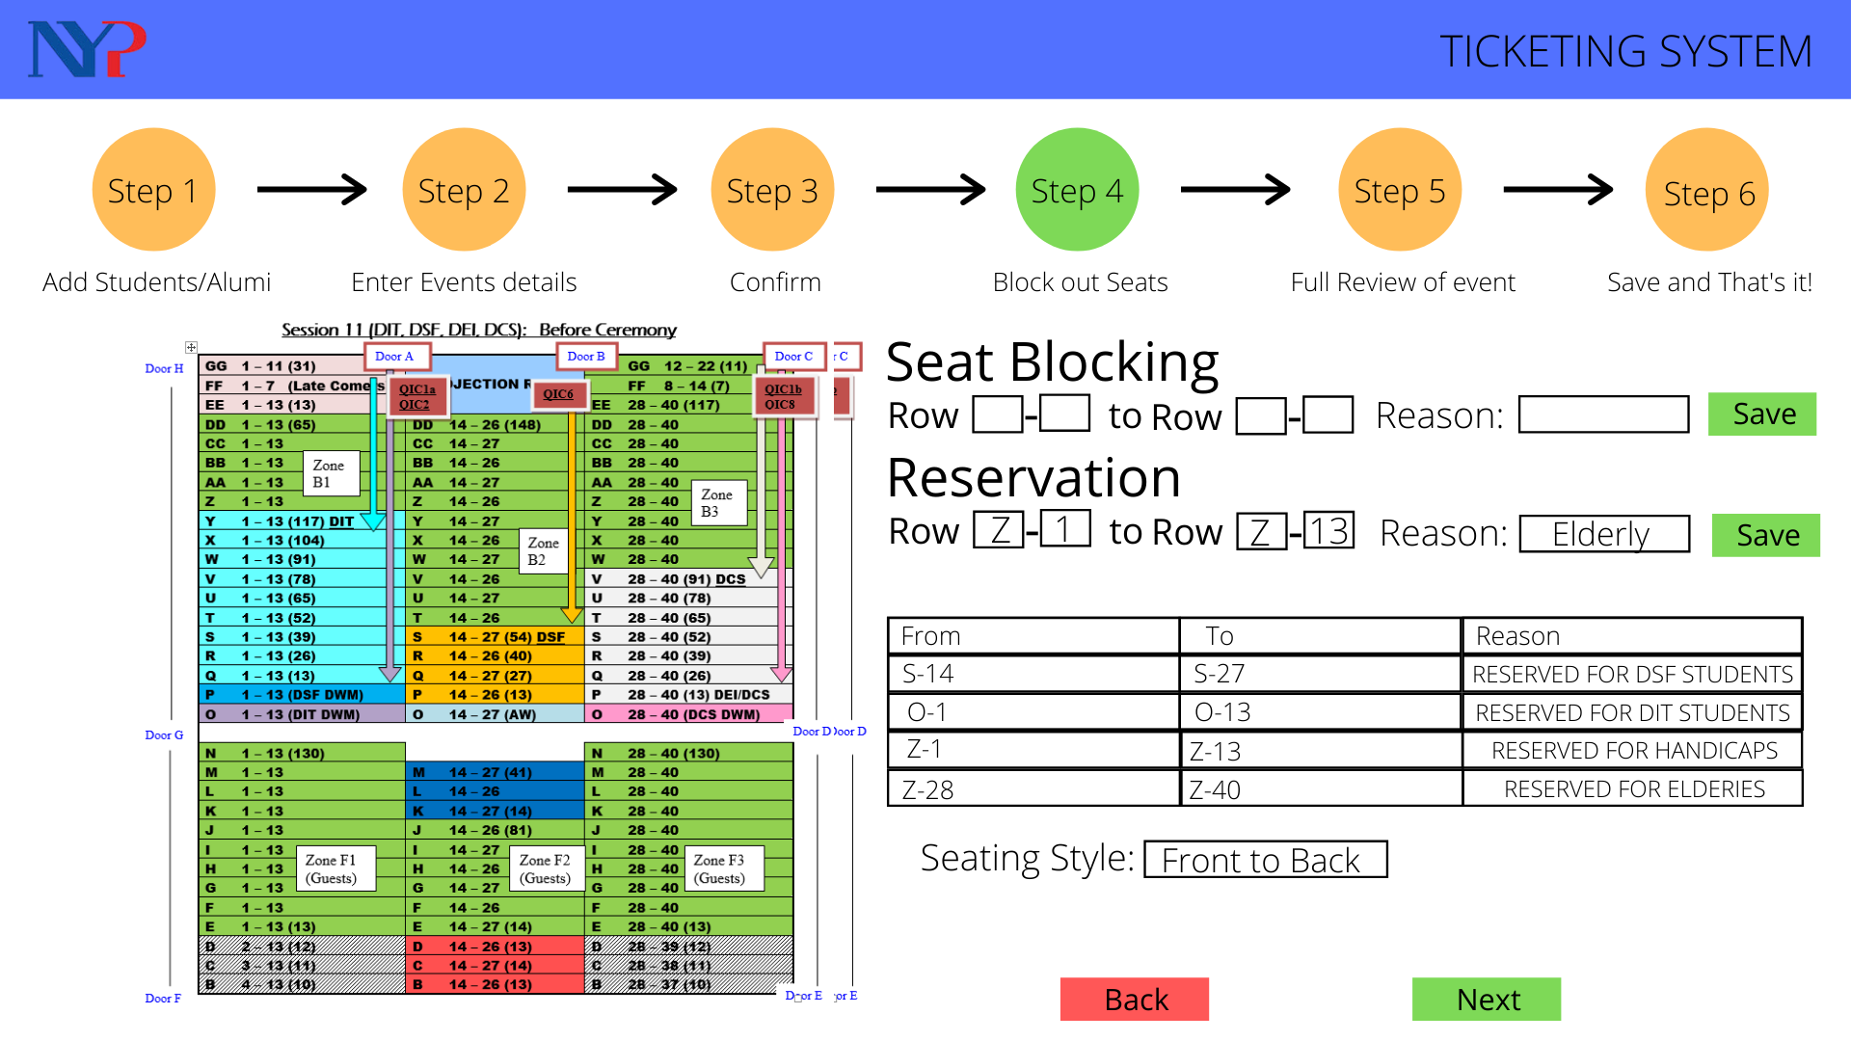
Seat Reservation

Slide 52
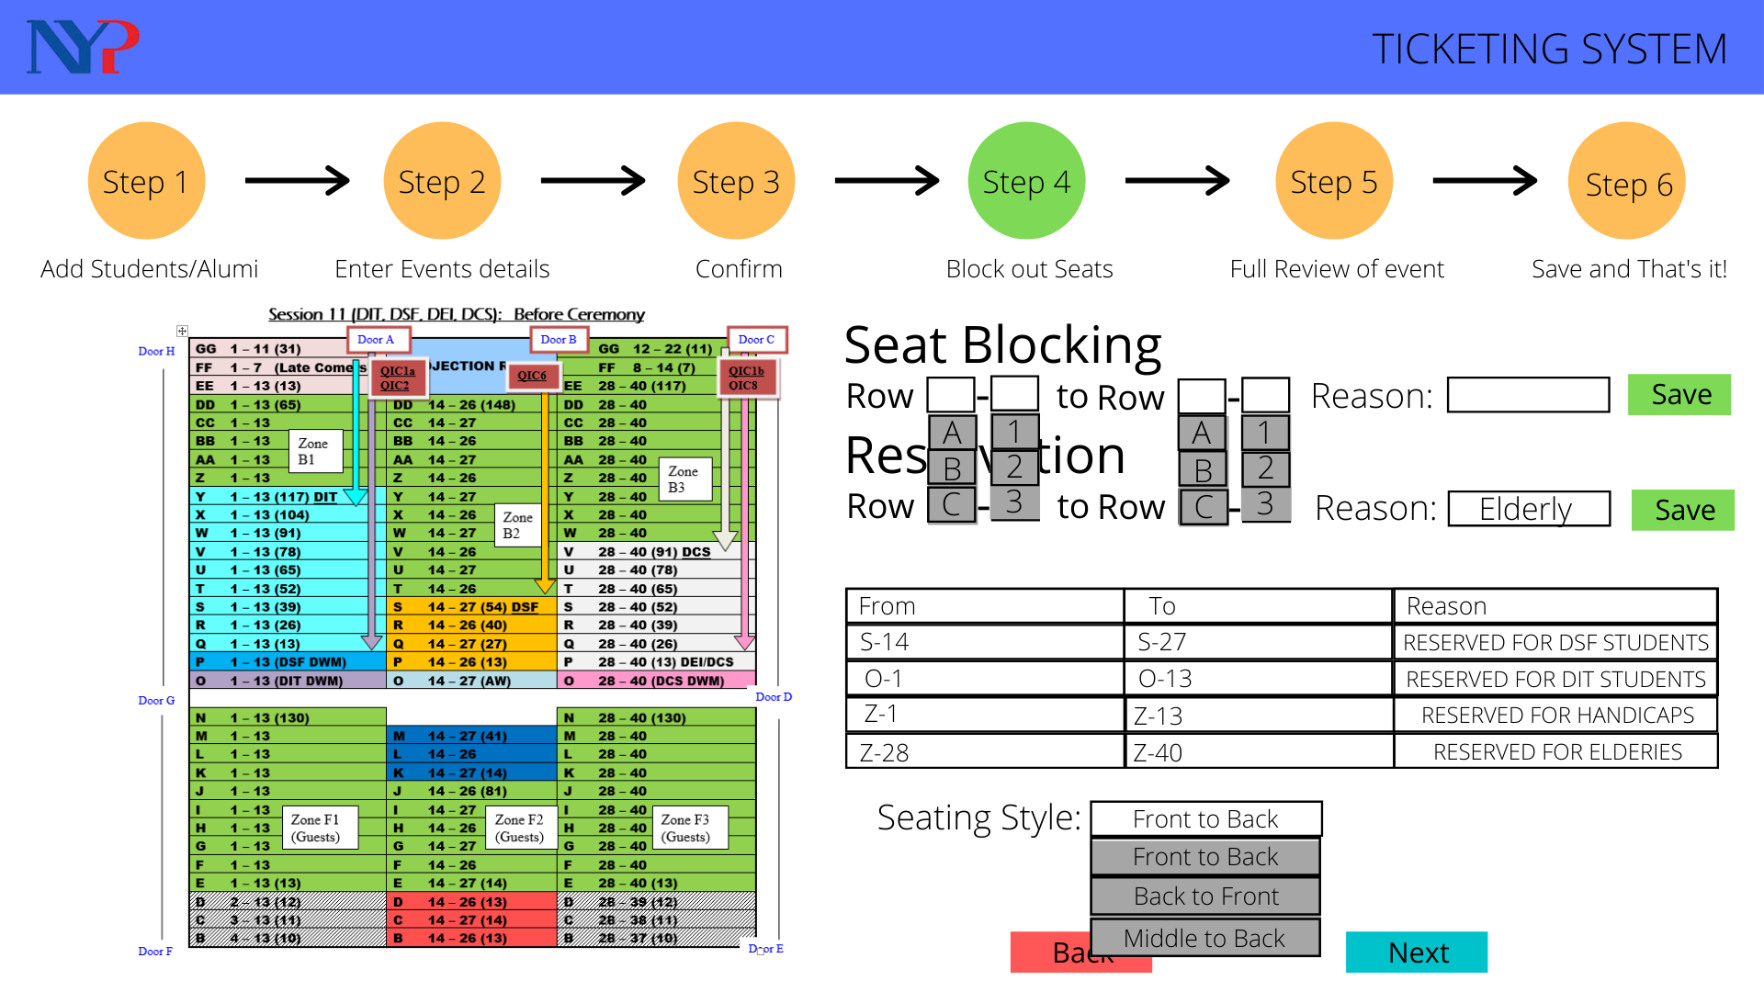
Drop down List

Slide 53
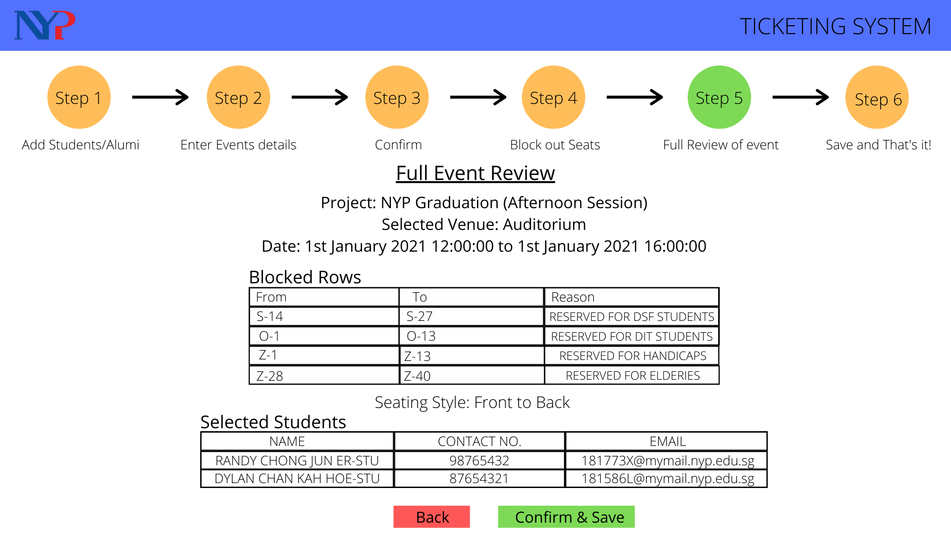
Full Event Review

Slide 54
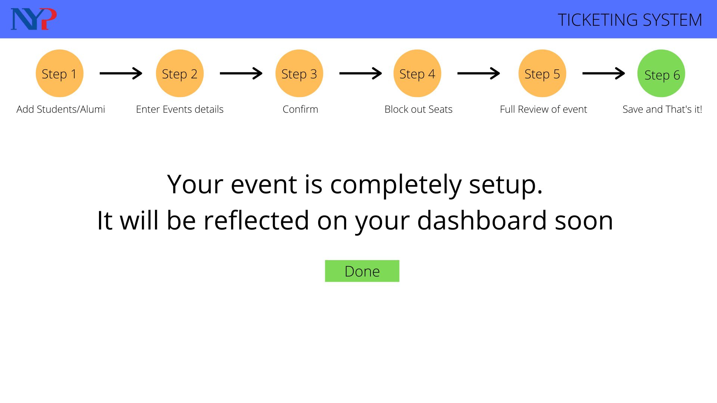
Confirmed Page

Slide 55
Creating New Student Account

Slide 56
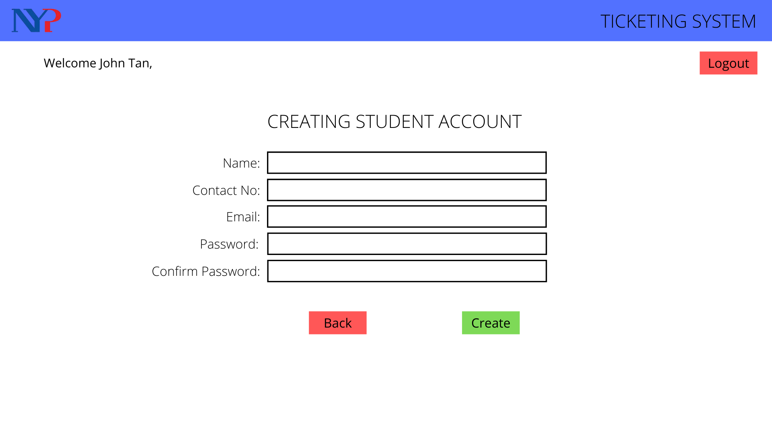
Creating Student Account Form

Slide 57
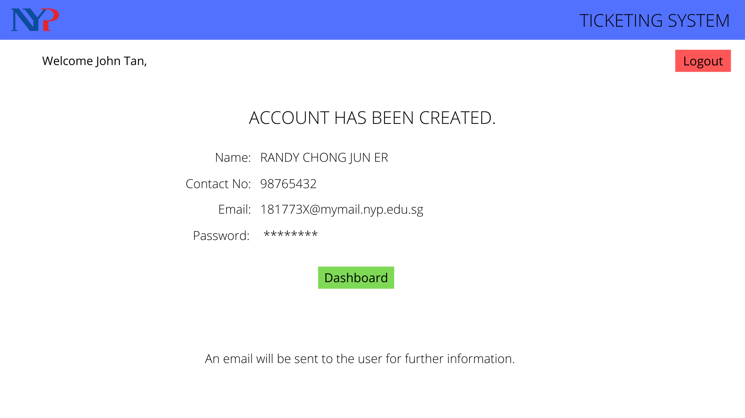
Confirmed Page

Slide 58
Editing Profile

Slide 59
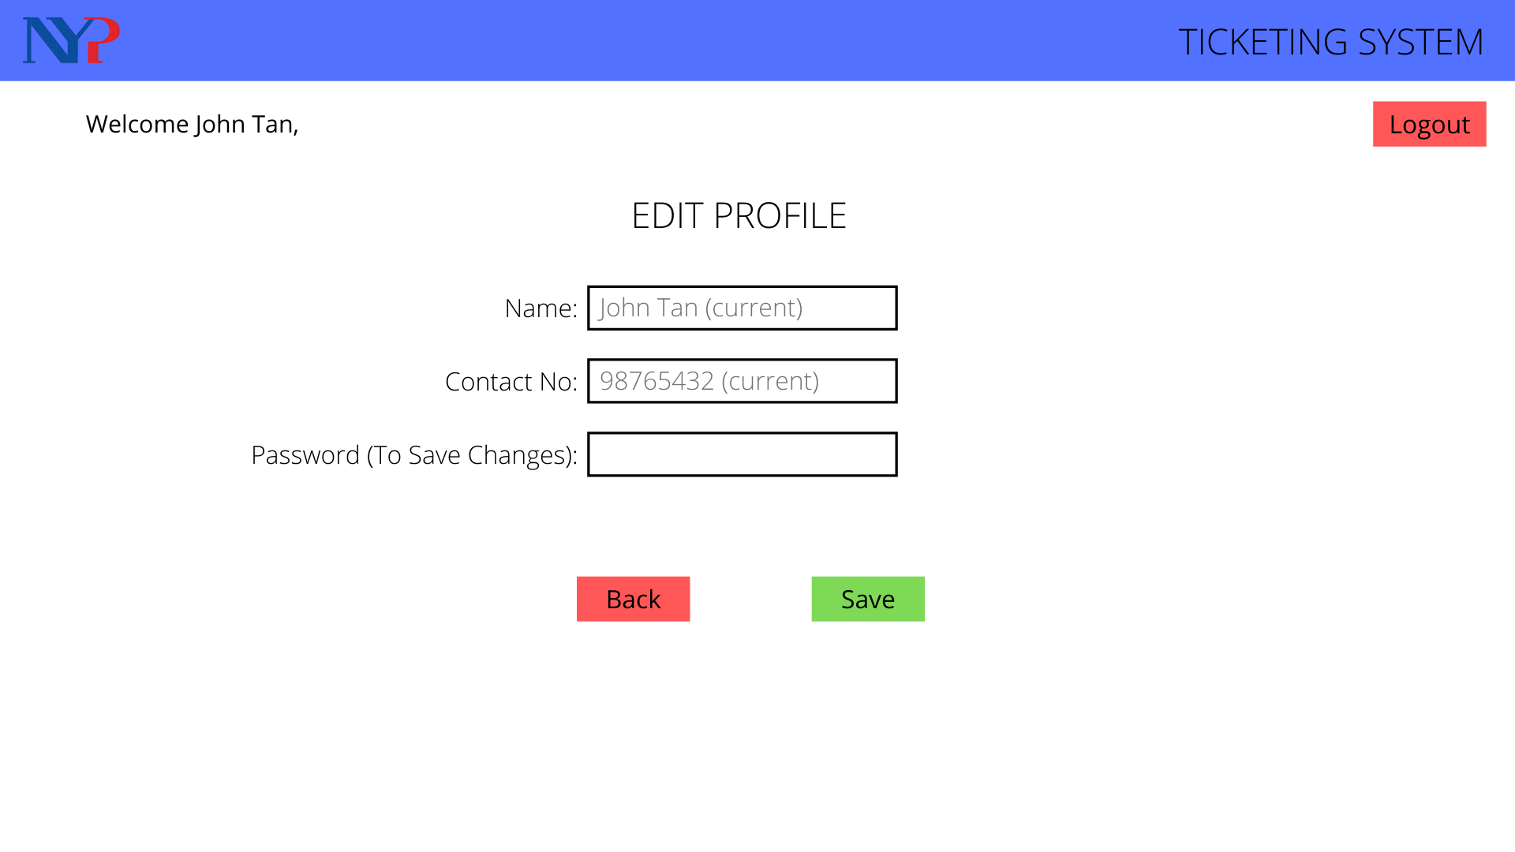
Editing Profile

Slide 60
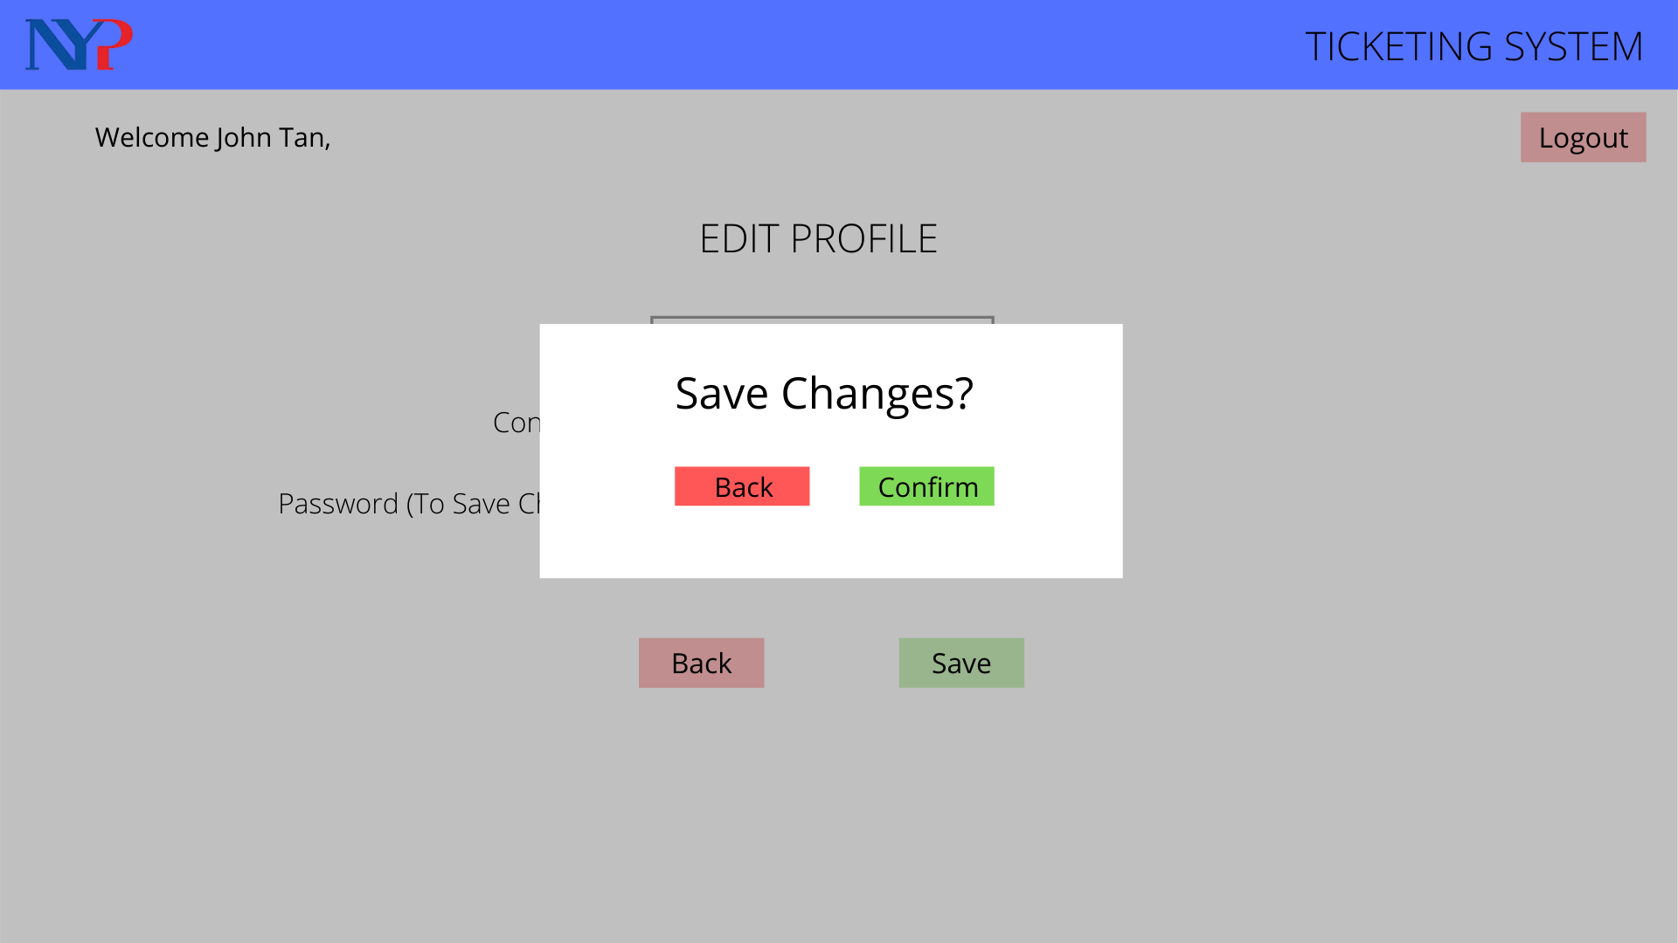
Confimation

Slide 61
Stage 4: Prototype Quickly (Admin)

Slide 62

Login Page

Slide 63
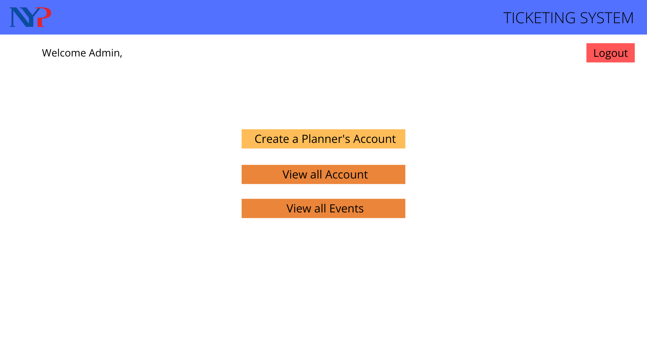
Dashboard

Slide 64
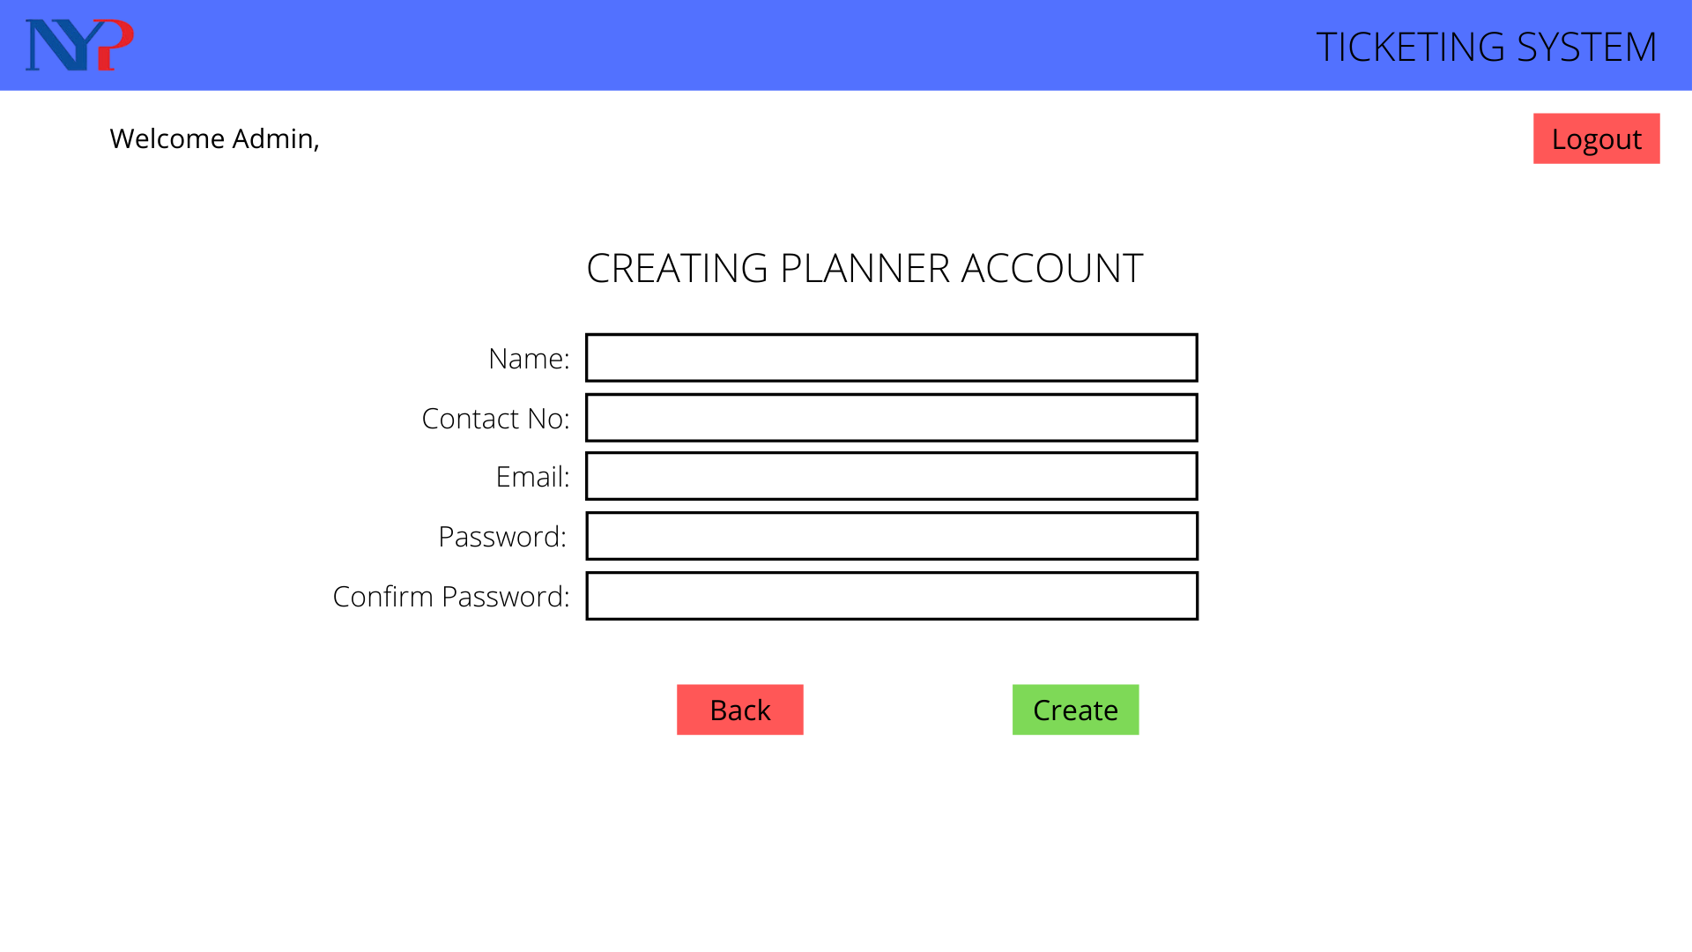
Creating Planner Account Form

Slide 65
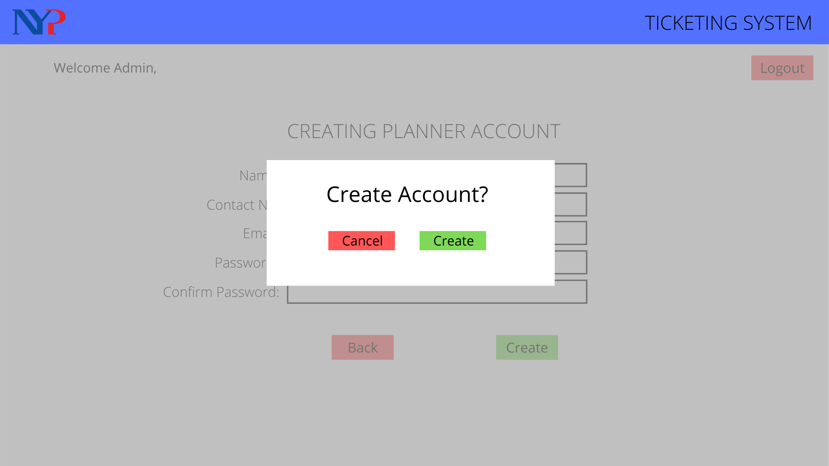
Confirmation

Slide 66
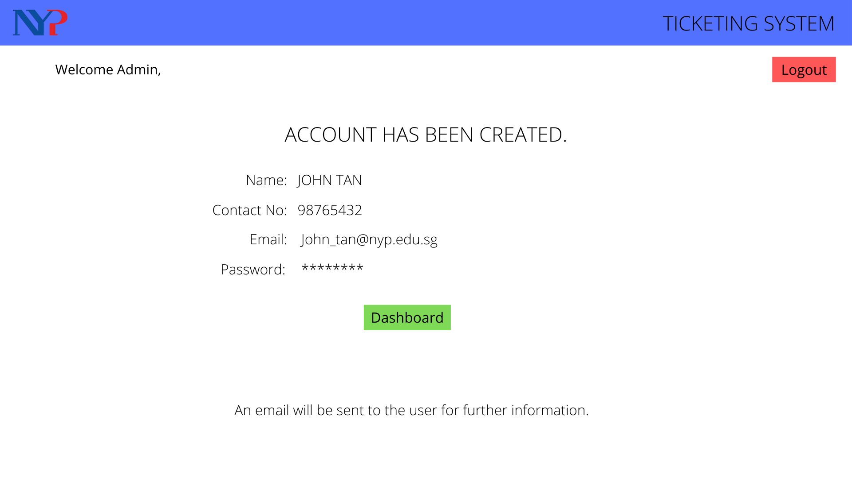
Confirmed Page

Slide 67
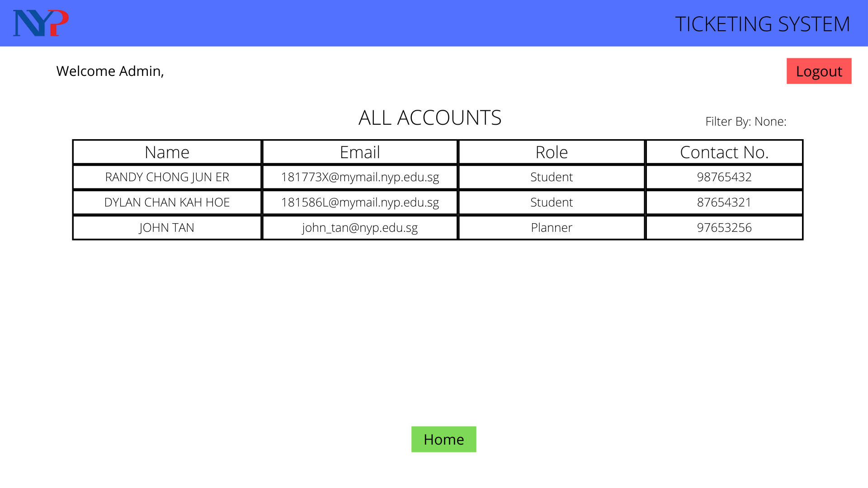
Showing all Accounts

Slide 68
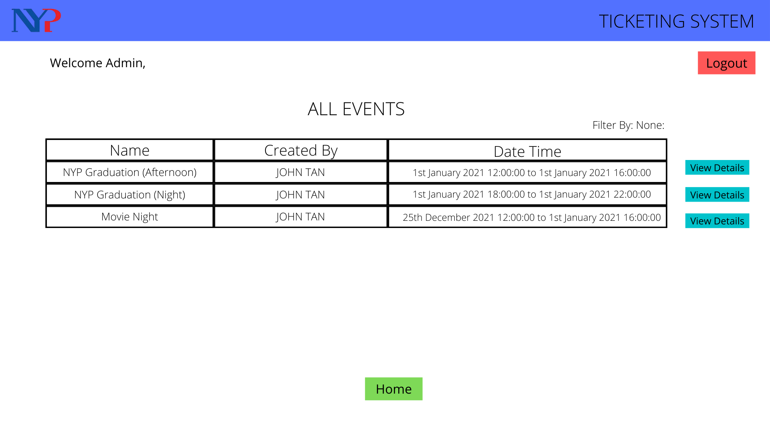
Showing all Events

Slide 69
Conclusion
Prototyping was difficult as there were a lot of things we have not consider while creating it, therefore there were multiple draft of it. I also had to change them midway through development as there were some limitation too.
Coding out the prototype out definitely helped us to understand the way things works and how we should be prepared for each outcome/possible scenario.
We also needed to think of several ways of how the database should be designed to fit the appropriate challenges we face and also think about user interface to make it more friendly for all ages

Slide 70
Reflection
I didn’t have much experience with how ajax works in asp.net and had to figure it out
It was tough to setup the maps correctly and be reflected on the reserved/blocked seats
Since the remaining half of the fyp was in school, i had to rebalance the way i work in school instead of at home
Design thinking process actually helped me a lot for the project

Slide 71
Technical Difficulties
Map have to be updated to show the reserved/blocked seats
Figuring out how ajax and webmethods works as i did not have any experience with them
Setting up the program to be able to use the SMS service on short notice
Not able to make the map responsive and curated to the user specifics
Making seats color coded based on it being reserved or blocked
Unable to have a working algorithm that allocates seats automatically
Spent 12 weeks before the current fyp doing mobile app development had to remember how web app development as it was different

Slide 72
Area of improvement
Map can be responsive and customisable for special area
Seat reservation drop down list cancelling out seats that are already reserved
There was not any user test done
Different color for block and reserve seat
Use of an algorithm to allocate seats instead of hard coding the messages and allocation

Slide 73
Prototype Demo

